Slide 1
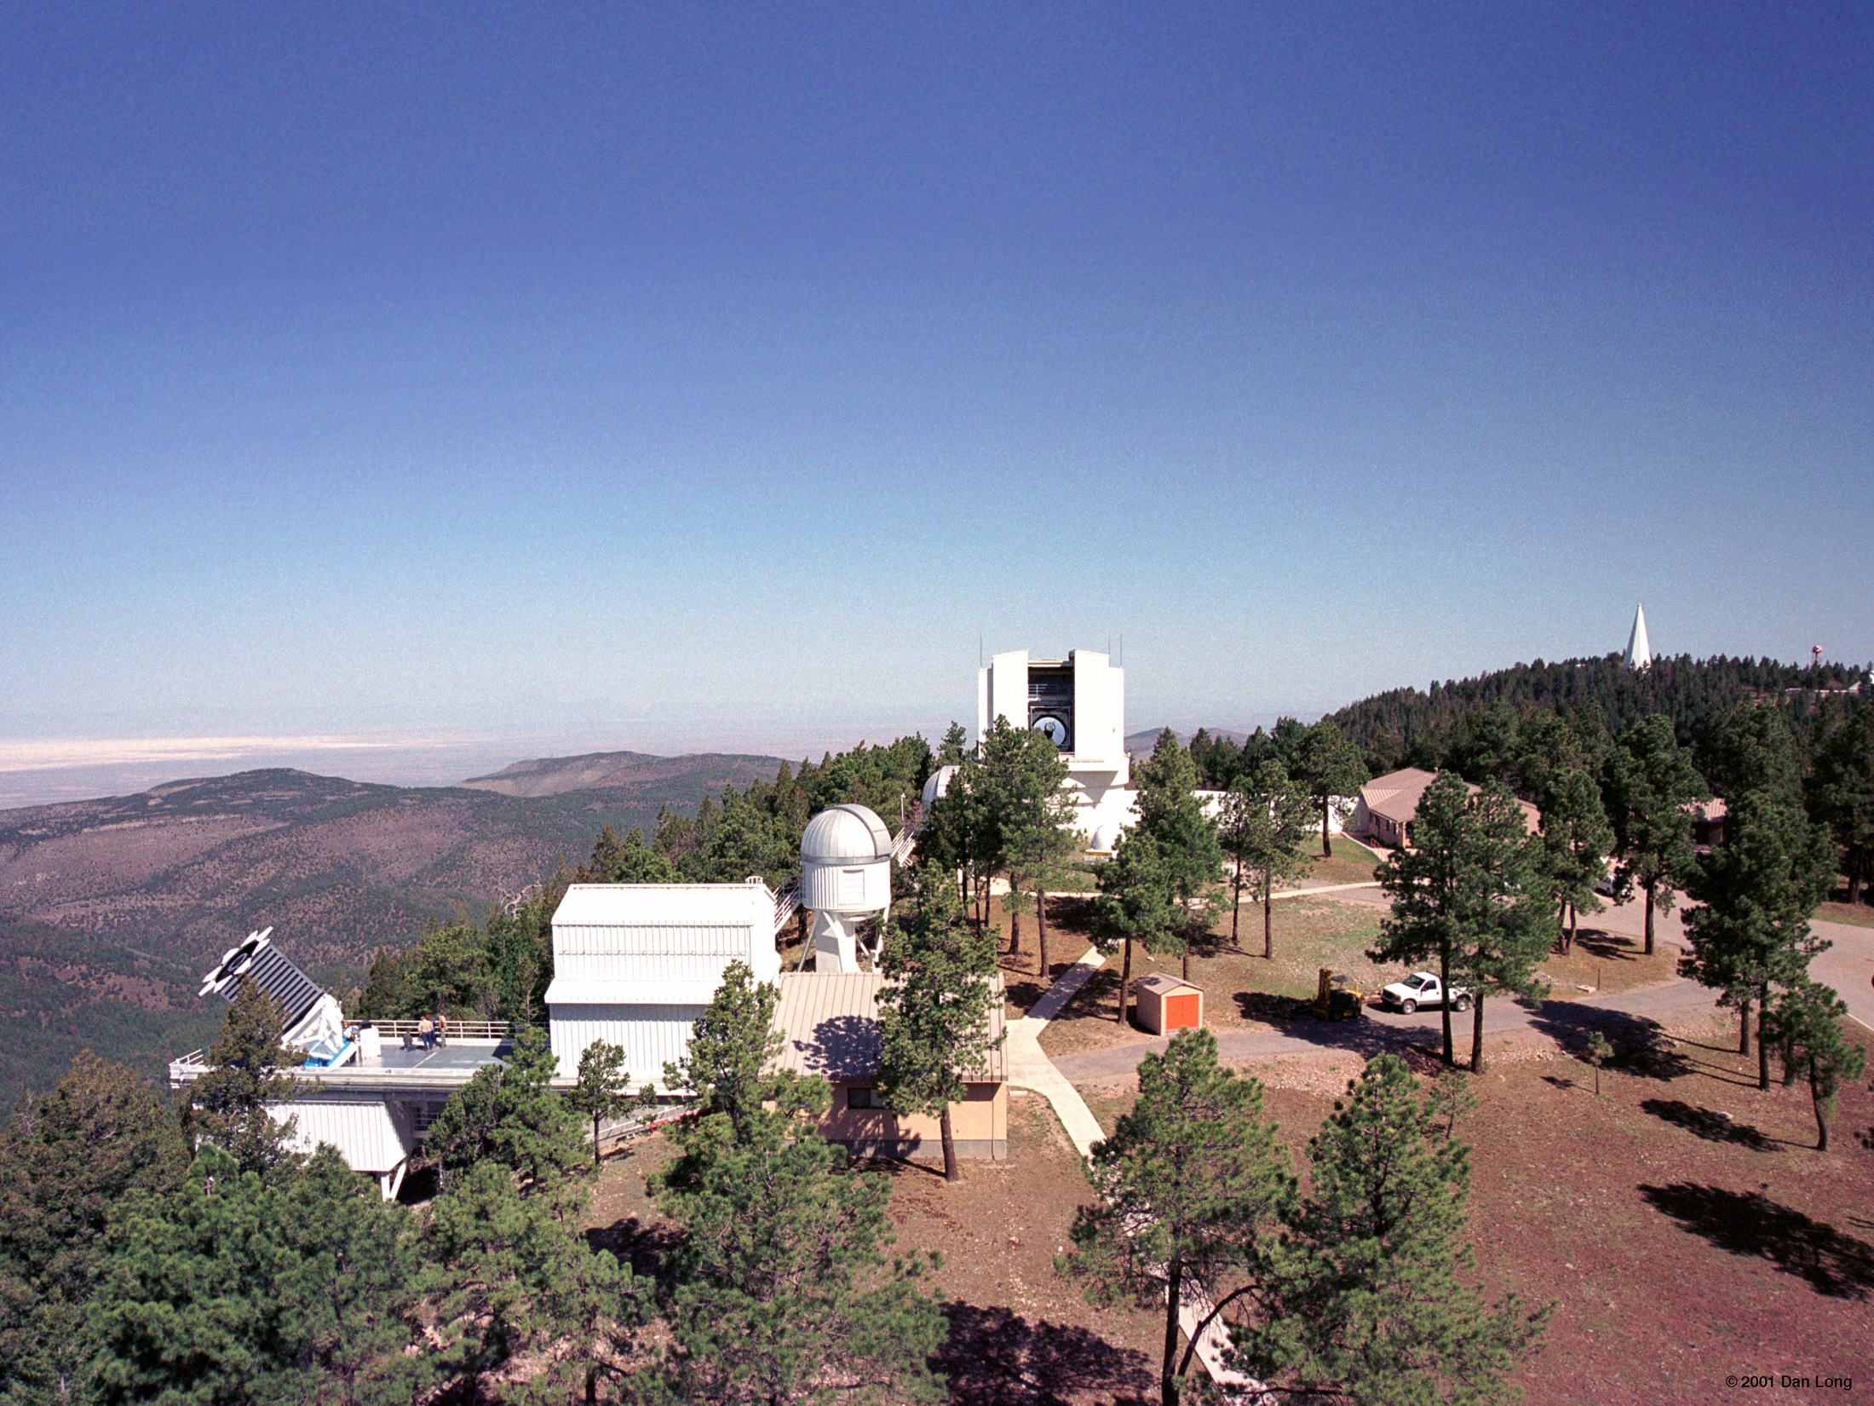
Astrophysical Research Consortium

Slide 2
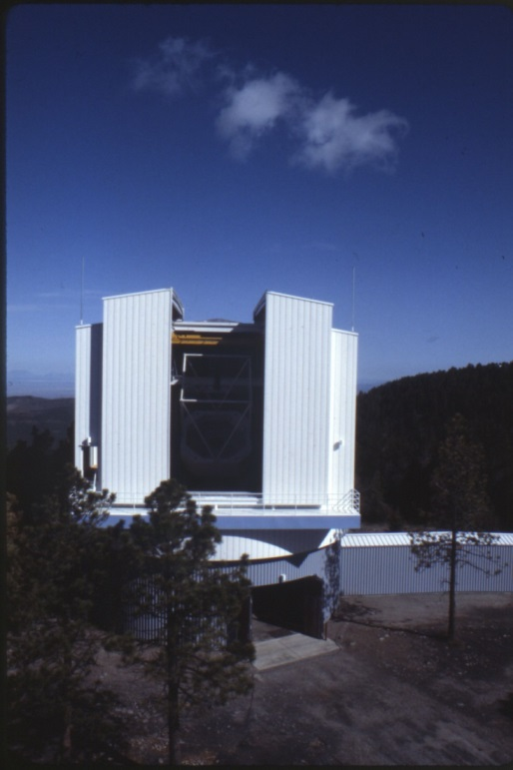
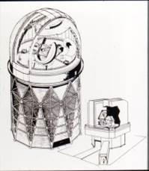
Introduction
By the 1950s, the biggest and best astronomy tools in the US were concentrated in a handful of universities.
AURA national observatories didn’t support the needs of a university department to implement long-term observing programs.
In 1984, NMSU, Princeton, University of Chicago, UW, and WSU formed ARC to create an observatory that provided telescope time based on investment.
Prior to ARC, none of the consortium members had telescopes greater than 1.0m and locations weren’t ideal.
Today, almost every telescope project is a cooperative effort – models of cooperation that rely on pioneering steps by groups like ARC.

Slide 3
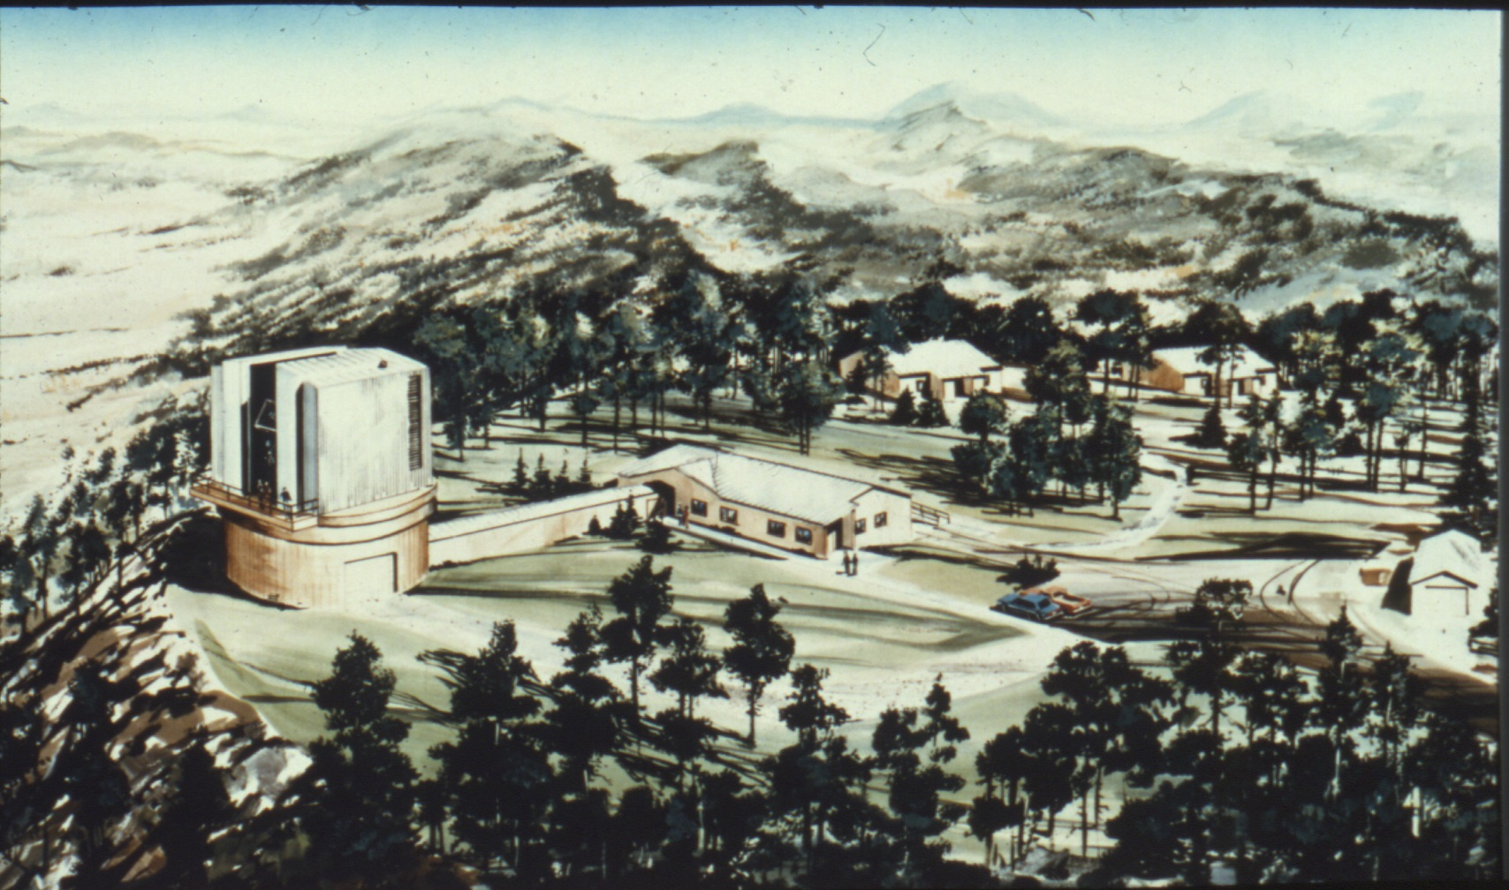
Plan for APO

Slide 4

Founding Members:
University of Washington
In 1965, UW hired Paul Hodge and George Wallerstein to join Theodor Jacobsen and expand the Astronomy Department.
Hodge and Wallerstein hired Ed Mannery and began to plan for an observatory but realized they needed a better location outside of Washington, a larger resource base for funding, and a partnership with other astronomy departments.
UW Regents authorized construction in 1965 and Hodge and Wallerstein spent the next ten years searching for potential partners.
By 1981, UW ranked second in allocation of NOAO telescope time among US institutions, and first in per capita allocation.
In 1978/79, Bruce Balick began exploring a partnership with Howard University, NMSU, and WSU and presenting ideas for an advanced technology telescope to groups around the country.
The results:
  a lightweight, 2m mirror only 6cm thick with a servo control system driven by computer for precision pointing
  a cost-effective site at Sunspot, NM on the Sacramento Peak campus of the National Solar Observatory
The overall project cost was estimated at $3.6 million.

Slide 5
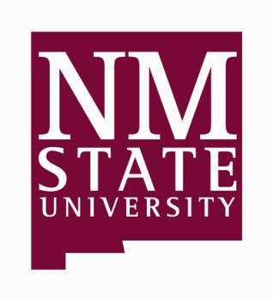
Founding Members:
New Mexico State University
In 1978, with a size similar to UW and as a frequent user of Kitt Peak, the NMSU Astronomy Department recognized the need to secure access to a 2+m telescope to support faculty and graduate research programs.
NMSU initially hoped to contribute $500K in cash and provide a site and operations building to meet a $900K commitment for 25% participation, but the partners decided that the Sunspot site was better and it was free.
In July 1981, NMSU committed to $576K for a 16% share, with hopes to raise more funds to buy a 25% share.

Slide 6
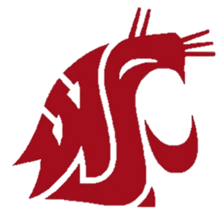
Founding Members:
Washington State University
Although WSU had a small astronomy program with only two observers, Tom Lutz and Julie Lutz, UW invited them to join.
Both groups had collaborated in the past at Kitt Peak and Manastash Ridge.
WSU could not add personal expertise, but they could contribute a small share of money for a small share of observing time.
For a 5% share, WSU’s commitment was $180K.
WSU would later sell its share to the University of Colorado at Boulder in July 2001, as it could not justify the cost nor fully use its telescope time.

Slide 7
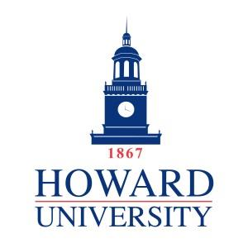
Founding Members:
Howard University
In the late 1970s, Ben Peery moved to Howard University to start an astronomy program. Balick (UW) contacted him, thinking that involvement in a telescope project would help grow the new program.
Peery proposed to buy a 30% share in the partnership, and Howard officials agreed to $1.08 million in funding contingent upon Congress approval.
In August 1981, the UW attorney general began drawing up an agreement for the four universities.
However, Howard’s request to Congress was excluded from President Reagan’s budget and never resurfaced.
Howard maintained an active role until the end but had to drop out in early 1982.

Slide 8

Founding Members:
Princeton University
In January 1981, Princeton found out they weren’t selected for a proposal to manage Hubble Space Telescope data acquisition and reduction but they still had a $1 million endowment originally intended for that project.
At this point, the department decided to get involved in ground-based astronomy.
Wallerstein (UW) mentioned in an early 1982 visit with Edward Jenkins that UW was forming a consortium to build a 2.5m telescope and Princeton’s $1 million would buy a substantial share of telescope time.
Chair Jerry Ostriker asked Don York to investigate participation in the project, but Don soon moved to the University of Chicago.
Princeton remained interested at a $500K level and lobbied for a larger telescope. Jim Gunn agreed to build a double imaging spectrograph.

Slide 9
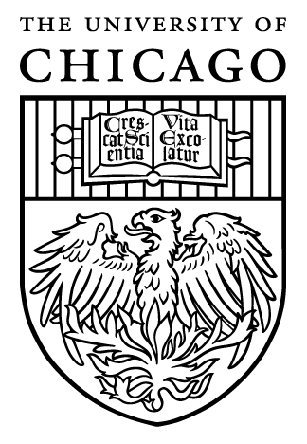
Founding Members:
University of Chicago
At UW, the telescope engineering group spent the rest of 1982 planning to building a larger 3m telescope, which would require another partner.
Chicago already had access to Yerkes Observatory and MacDonald Observatory in Texas, but access to newer and larger telescopes was more difficult.
In fall 1982, York moved to Chicago, after Dean Stuart Rice had suggested building a big telescope earlier that year.
Rice was on the National Science Board and received a letter suggesting that space telescopes should be the national telescopes and the NSF should fund other ground-based projects.
Having just explored this topic for Princeton, York had the solution and Chicago signed up for a share equal to UW.

Slide 10
Formation of ARC
First administrative hurdle: divvying up the telescope and designing an effective form of governance, a task taken on by Bruce Margon and Don Baldwin (both UW) for most of 1983.
The Consortium Agreement was signed by all members on January 26, 1984 and effective January 1, spelling out the obligations and allocations of each member.
The breakdown: UW 31.25%, Chicago 31.25%, NMSU 15.625%, Princeton 15.625%, and WSU 6.25%.
The Board of Governors has two representatives from each university (one scientist and one administrator/business person).
At a summer 1983 meeting, Julie Lutz (WSU) proposed the name “Astrophysical Research Consortium.”
ARC incorporated as a non-profit in Washington State on June 26, 1984 and received non-profit status on October 25, 1984.

Slide 11
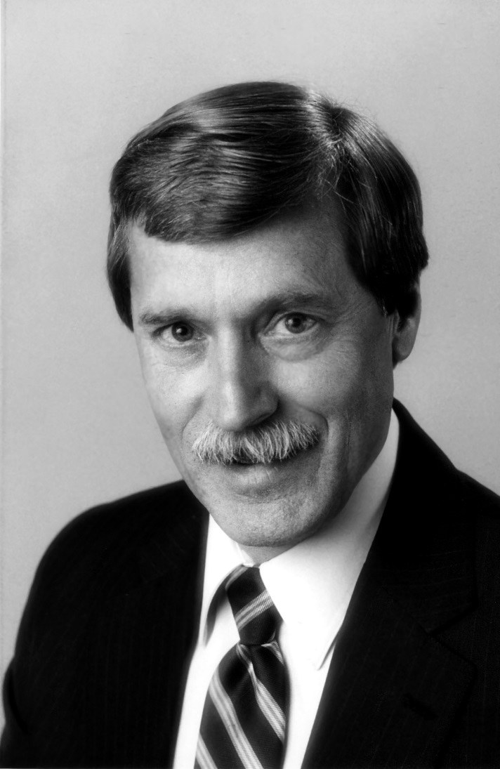
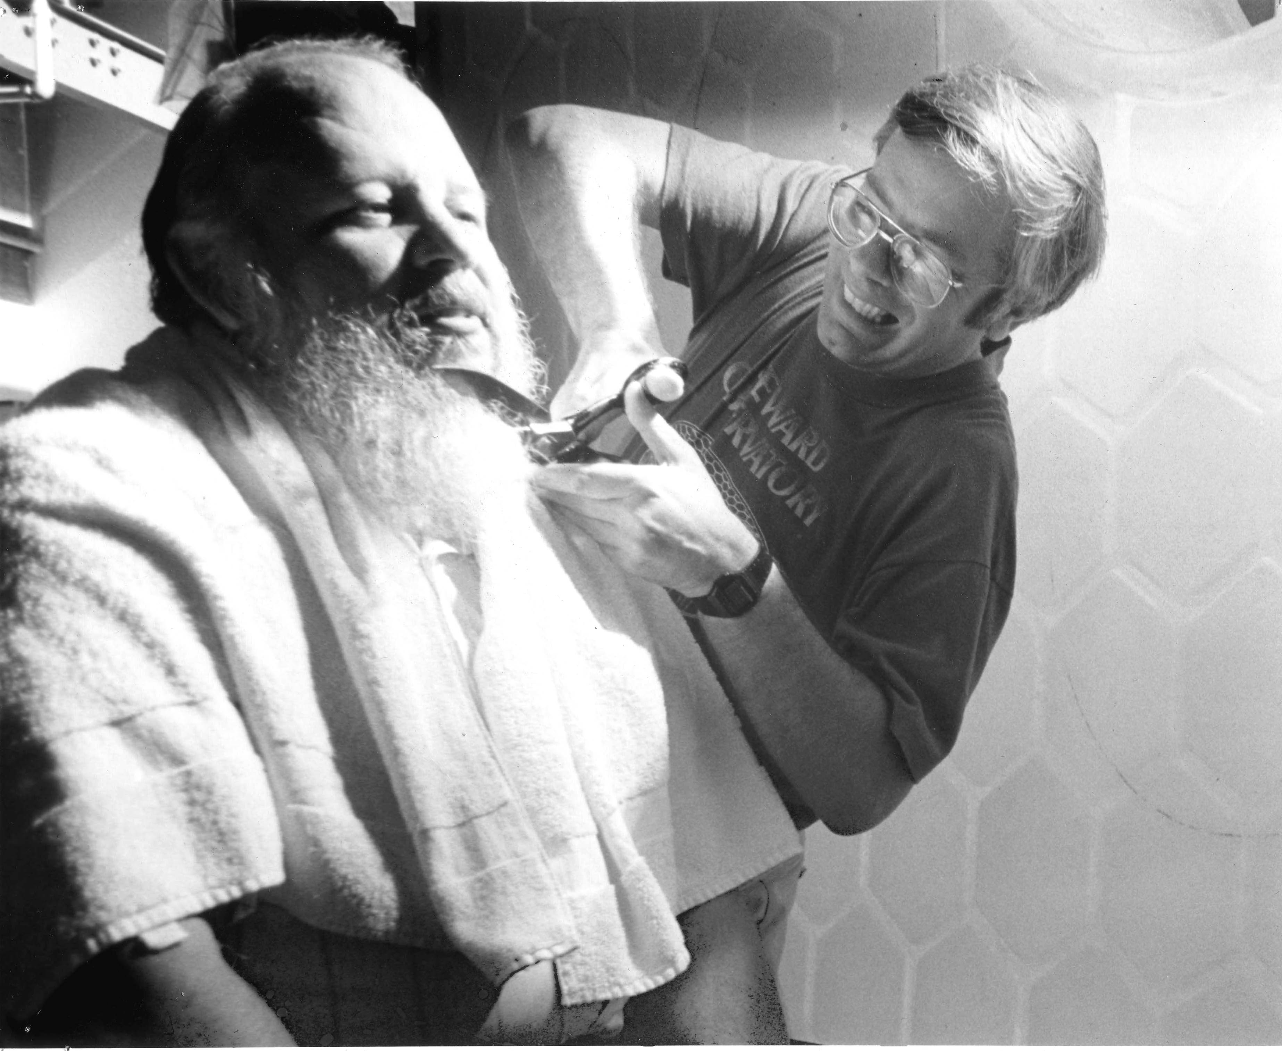
Don Baldwin, Don York & Roger Angel

Slide 12

Project progress continued in 1983 with the final selection of the Sacramento Peak site near Sunspot, selection of a 3.5m mirror, and development of detailed concepts and budgets.
Consortium members decided to name the site Apache Point, with final approval coming from the Forest Service on April 17, 1985.
In 1984, the group could elect officers, make appointments, and begin spending their contributed resources.
In the first meeting, Margon was voted the Chair of ARC, Baldwin the Secretary/Treasurer, York the Director of the Observatory, Anderson the Assoc. Director for the Site, Balick the Assoc. Director for the Telescope, and Al Harper (Chicago) the Assoc. Director for Instruments.

Slide 13
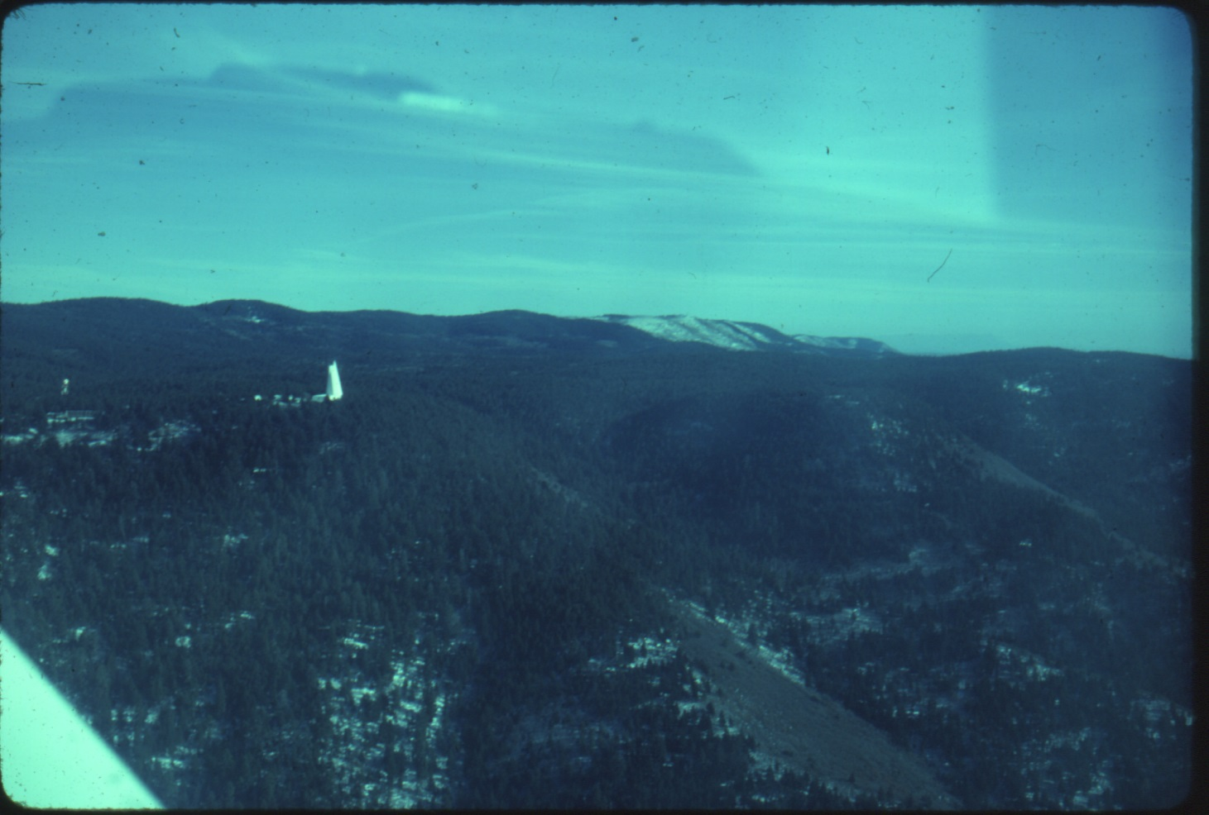
Sunspot, New Mexico
Future home of APO

Slide 14
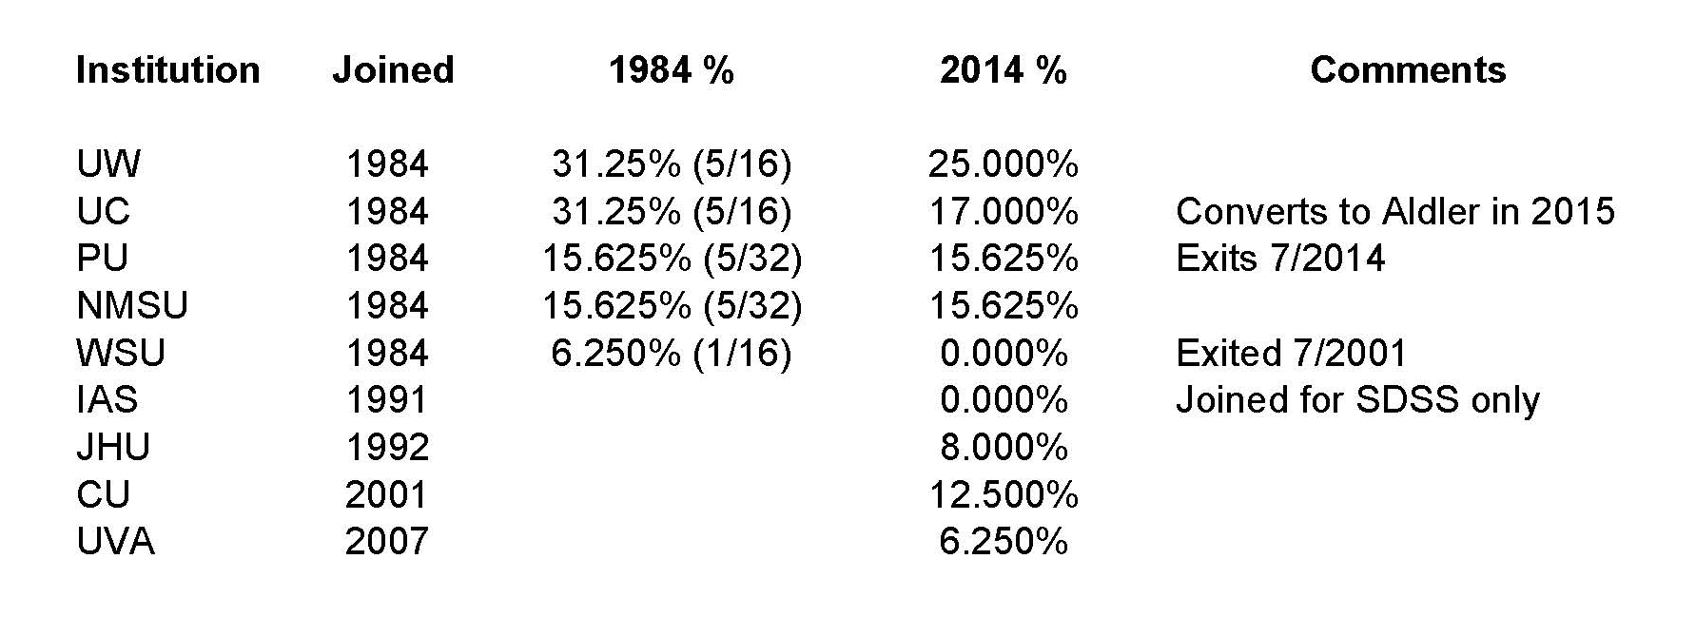
ARC Members: Then & Now

Slide 15
Fundraising
Funds provided by ARC came from state sources and private donations to the member institutions.
Members continued to look for sources to fund their individual membership dues and developed a plan for ARC to approach national organizations for funds that would reduce dues on a pro-rata basis.
Although individual members found success, the coordinated effort from ARC did not. However, ARC found huge success with NSF funding.
Once ARC formed, proposed budgets for 1984 ($1m) and 1985 ($4m) were put in place to start design and building of the telescopes and facilities and to complete site preparation.
With rising costs, tough decisions had to be made, such as eliminating an on-site aluminizing facility at the observatory.

Slide 16
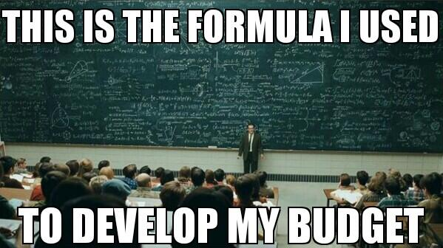

Slide 17
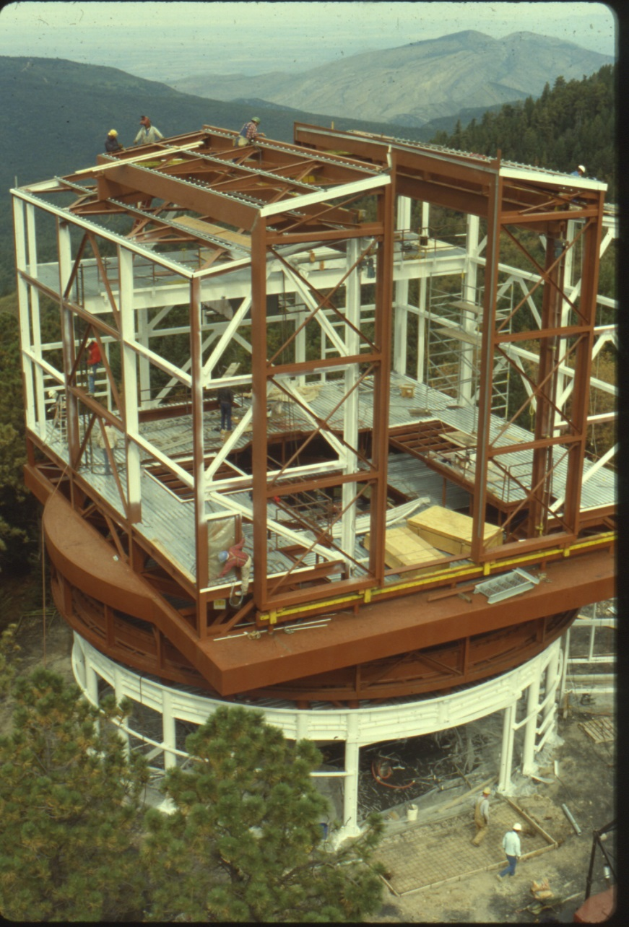
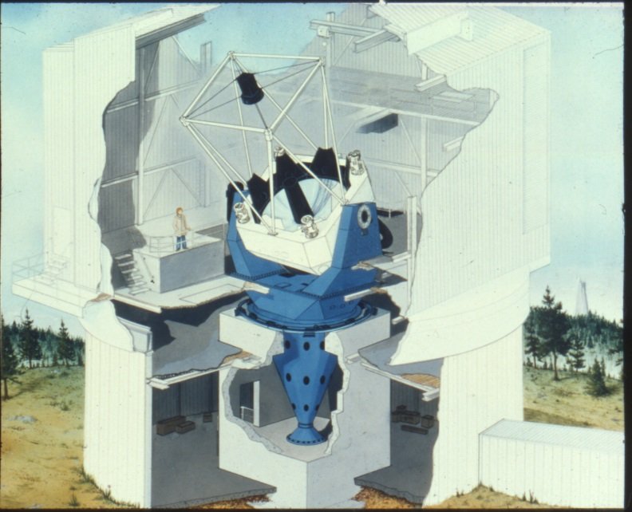

Slide 18
NSF Proposal
Originally, members planned to submit a proposal by the end of 1983 for $3.75 million, but by the time it was submitted in May 1984, the amount had grown to $5.565 million.
The in-person peer review took place on October 23, 1985 and in early 1986 NSF asked ARC to consider a revised budget of $3.3 million.
ARC agreed to accept the revised budget and move forward with telescope fabrication. NSF agreed to give $450K more, with ARC members coming up with the remaining $750K.
Given budget restraints, only the echelle spectrograph, 2m camera and a makeshift CCD camera could be finished.
On July 11, 1986, NSF granted ARC $3.74 million but the project was behind schedule by one year.

Slide 19


Slide 20
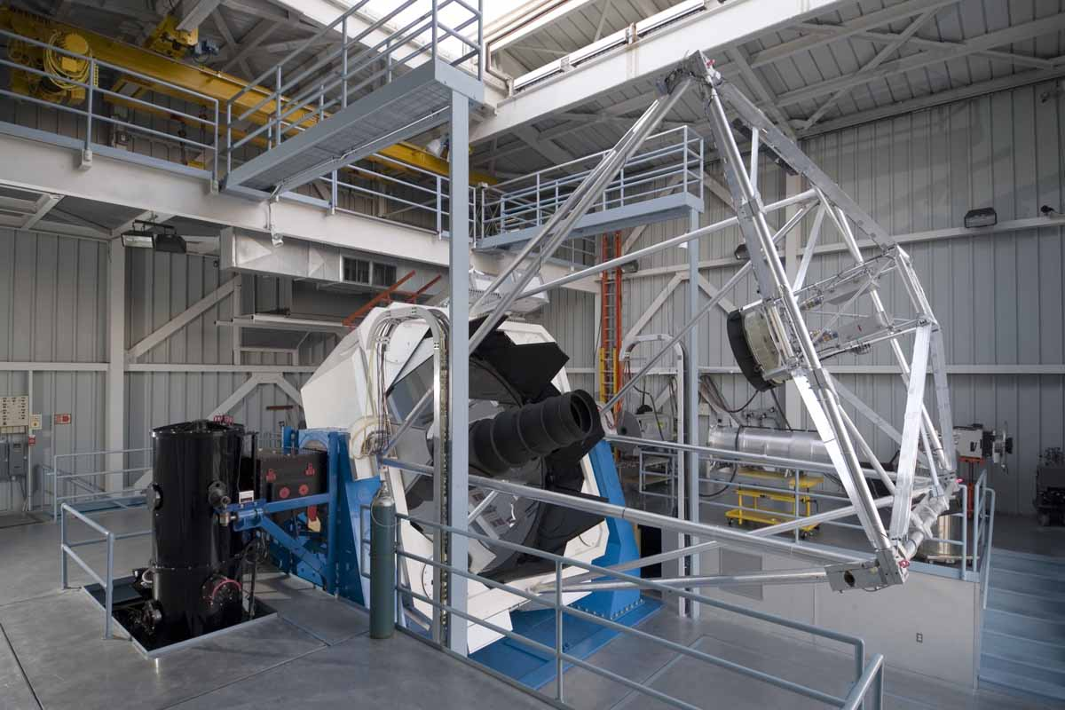

Slide 21
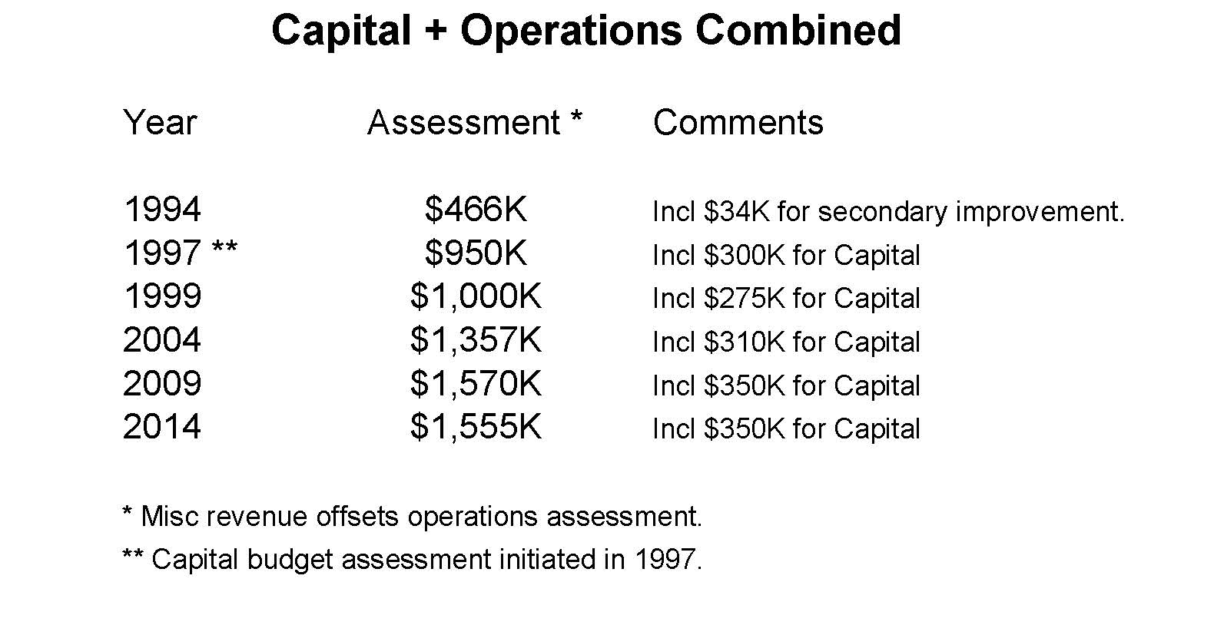
Annual 3.5m Telescope Assessments

Slide 22
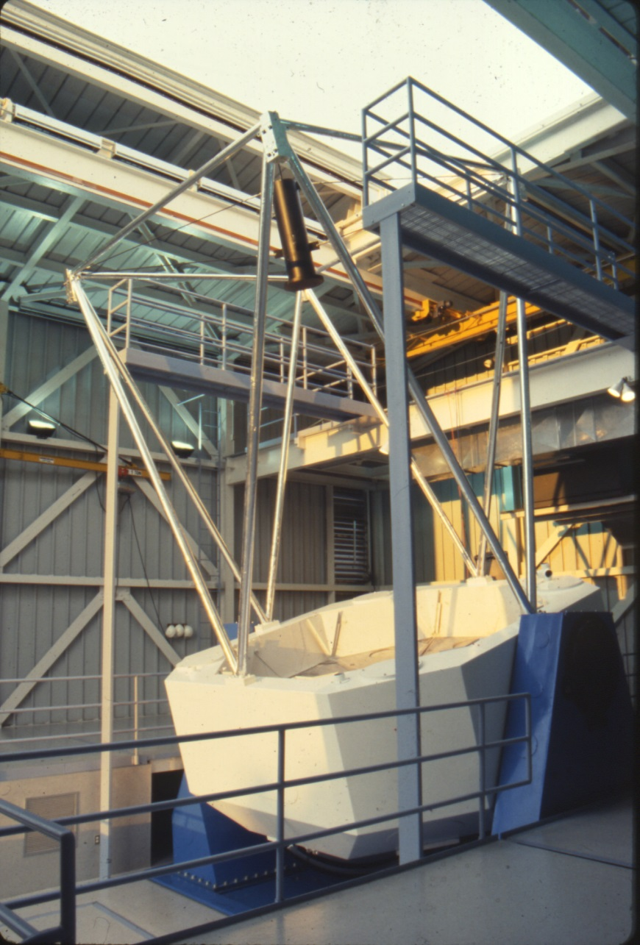
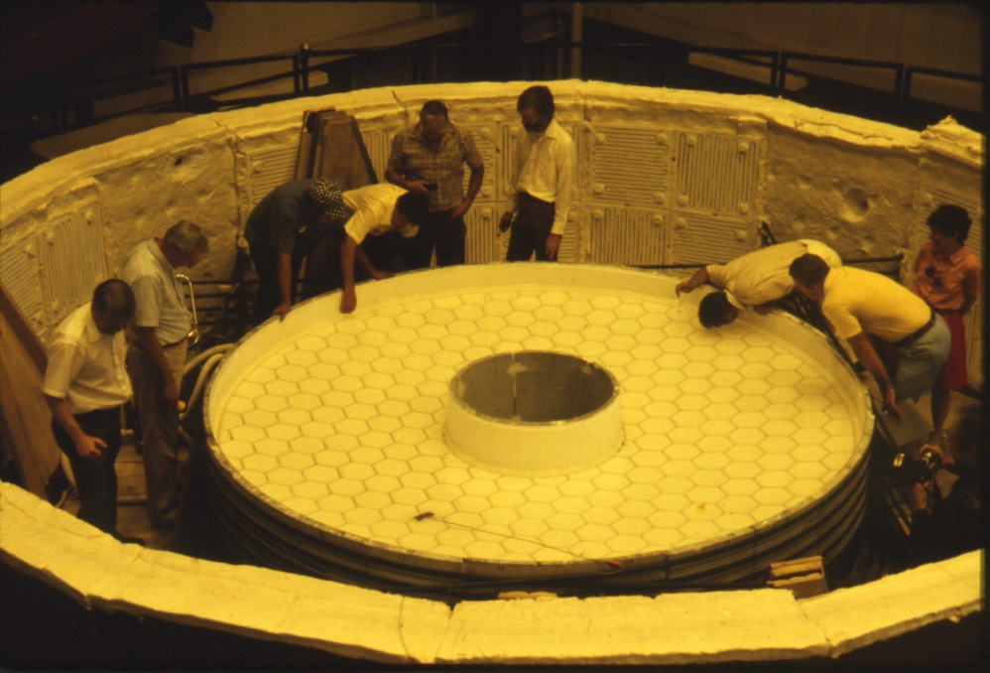

Slide 23
Completion of APO
In early 1993, with the primary mirror on site, ARC set a date for the dedication to coincide with a rare annual solar eclipse the following year.
The eclipse took place at 10:30am during which guests from the Goddard Space Flight Center imaged solar spectral lines with their 12m spectrometer.
The dual imaging spectrograph (DIS) built by Gunn took its first images in April 1994 and has since become the observatory workhorse.
On May 27, 2004, ARC celebrated the 20th year of its existence and the 10-year anniversary of the 3.5m telescope. The accomplishments: creating a thriving organization, constructing a world-class observatory, and fulfilling its goals of building strong astronomy departments and conducting great scientific work.

Slide 24
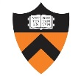
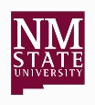
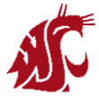

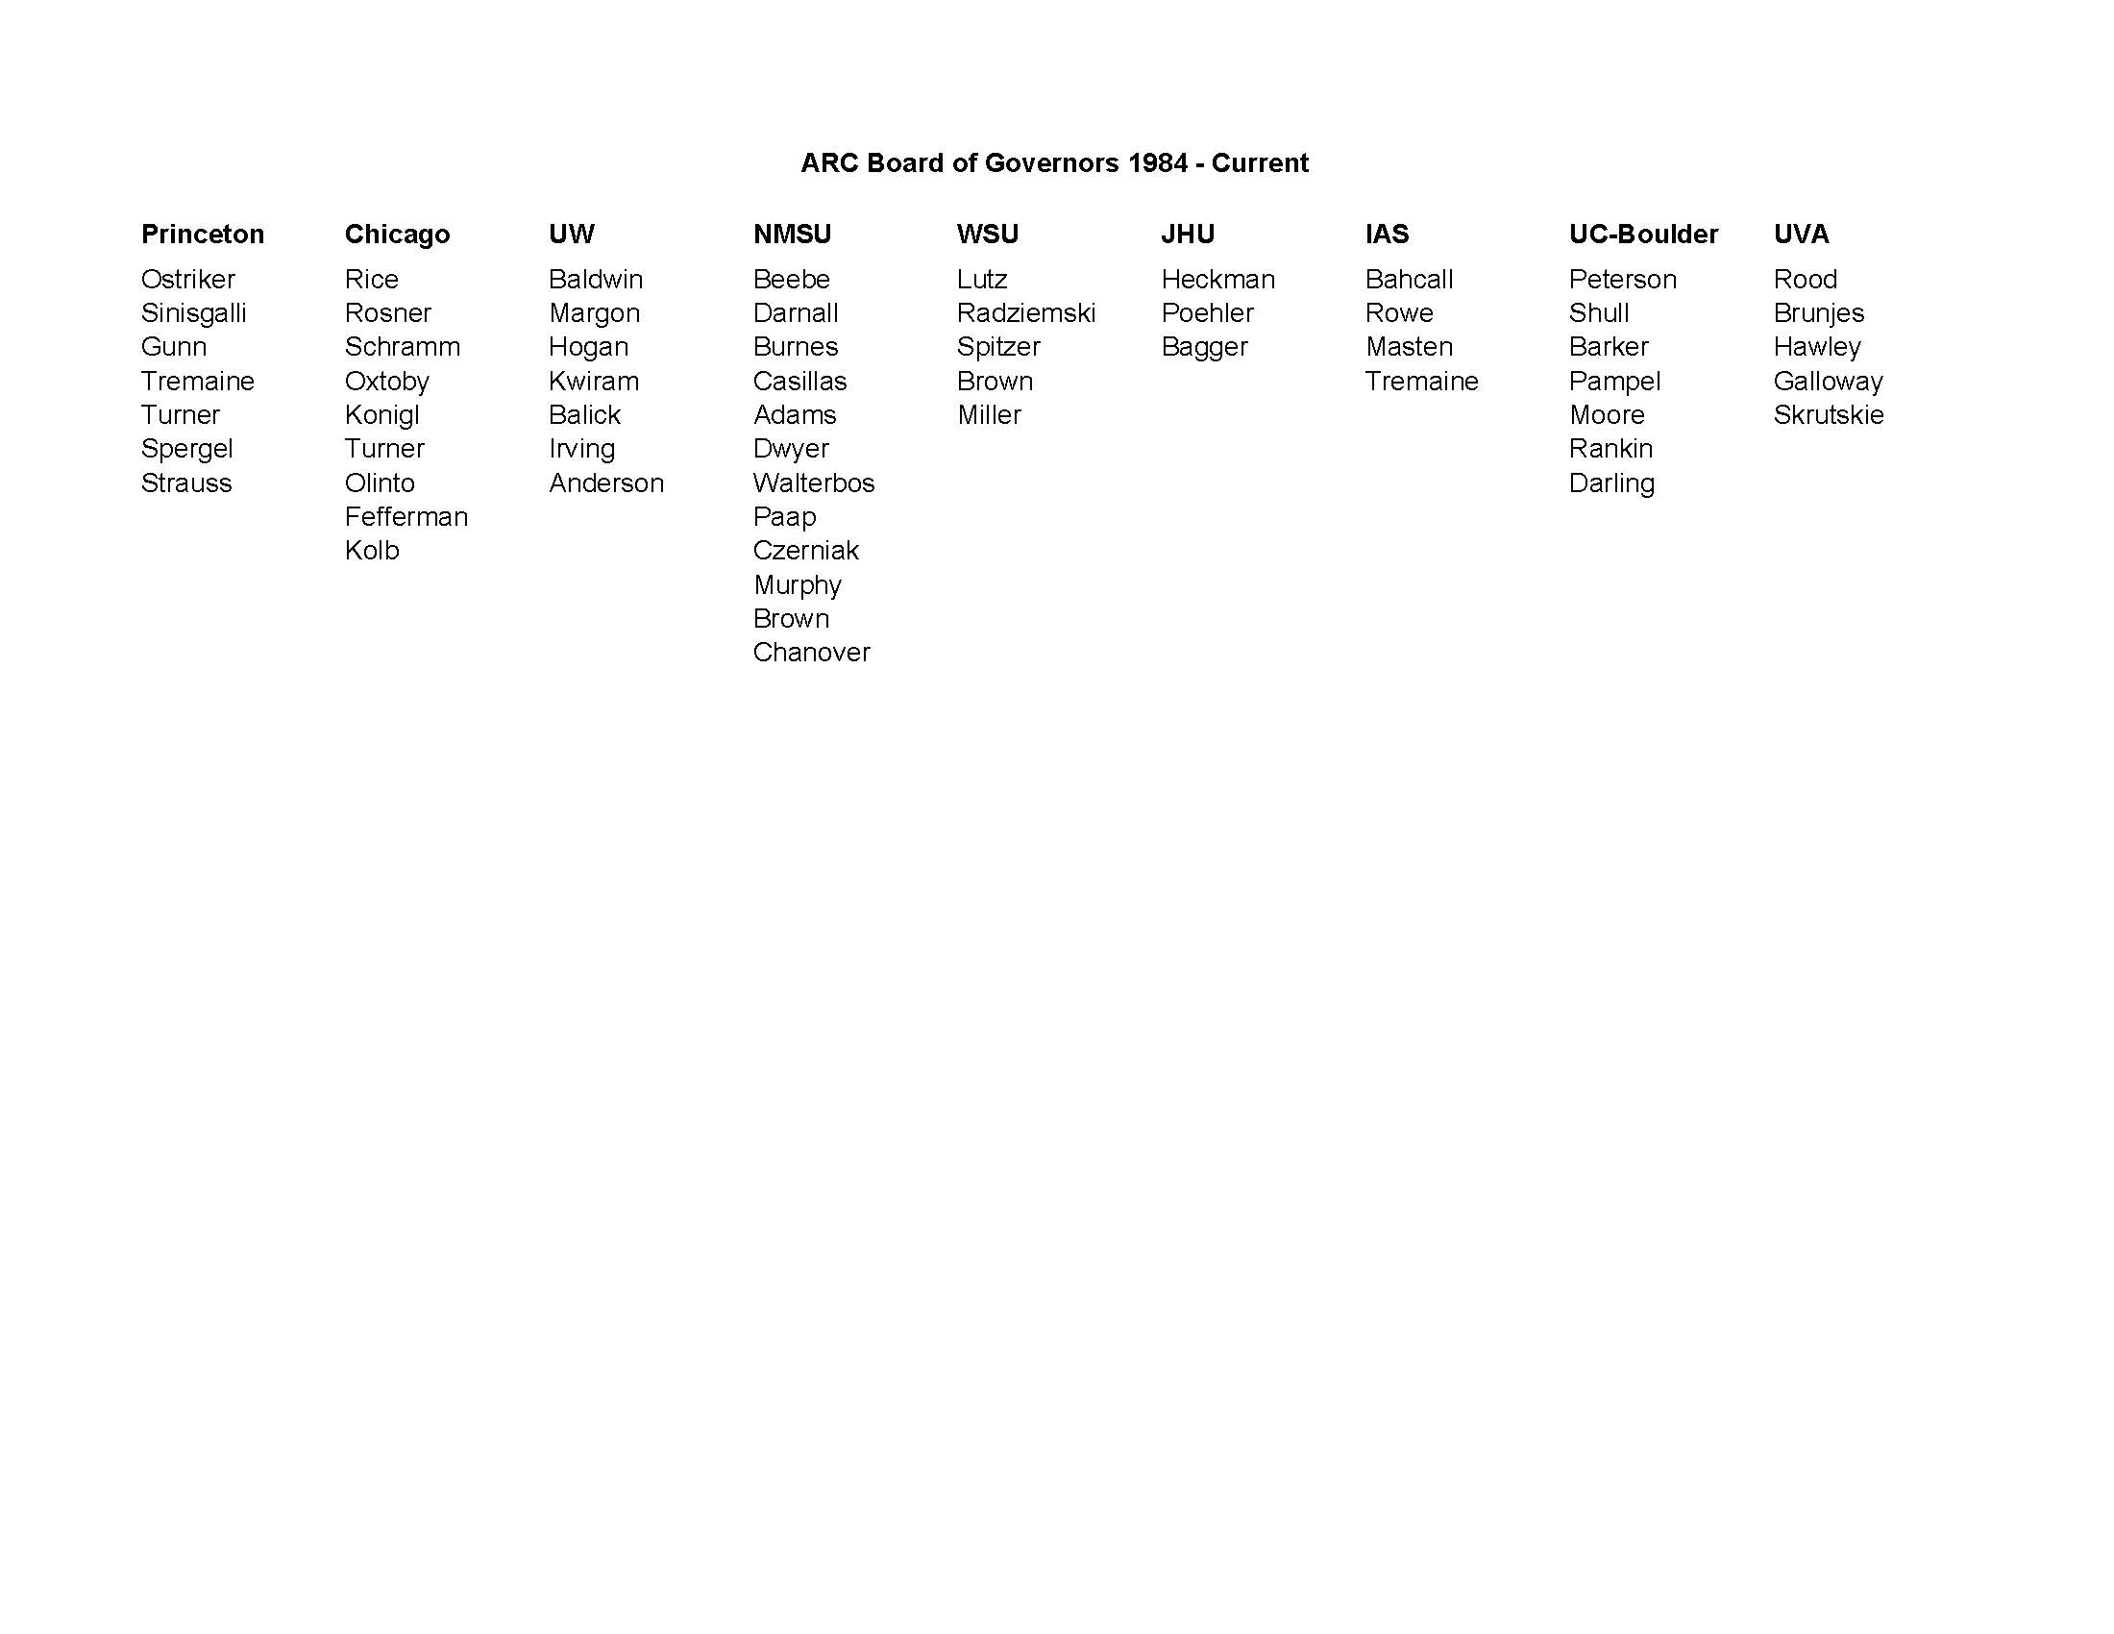

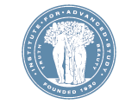
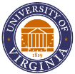

Board of Governors
1984 - Current

Slide 25
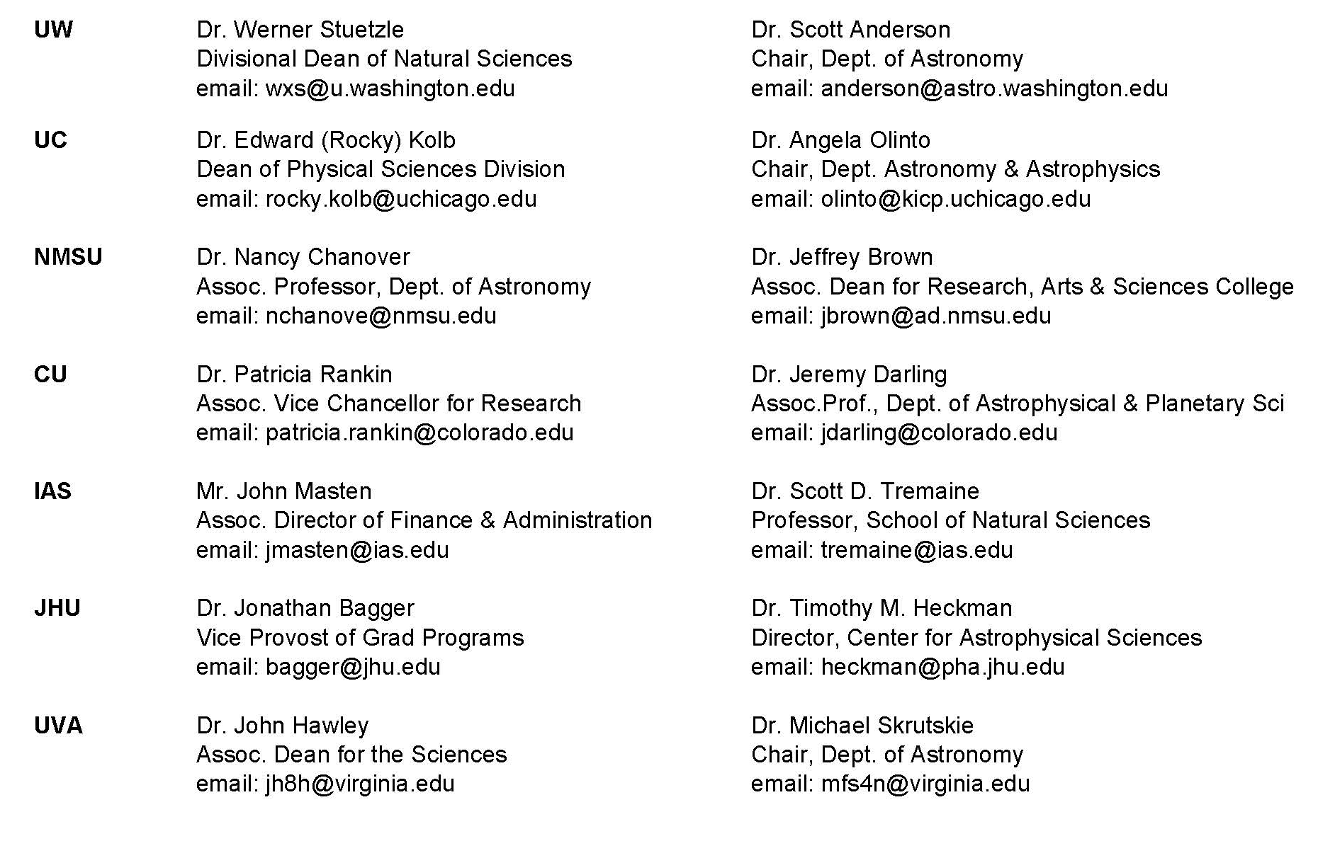
Board of Governors as of May 1, 2014

Slide 26
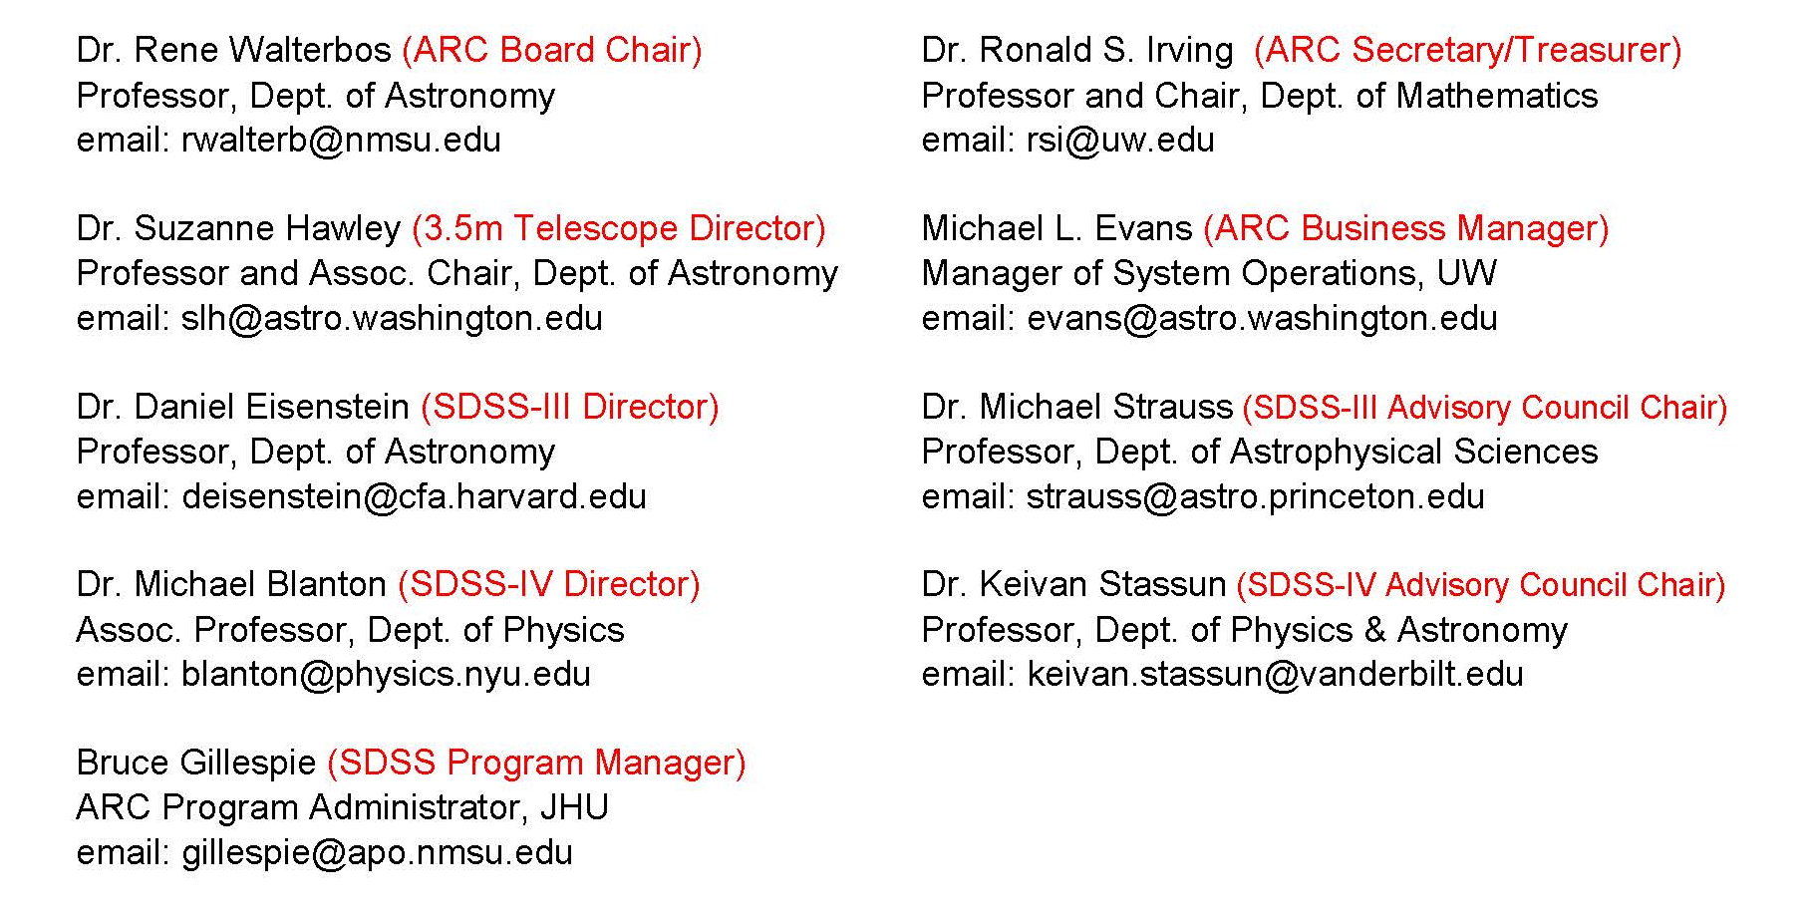
Administrators & Directors as of May 1, 2014

Slide 27
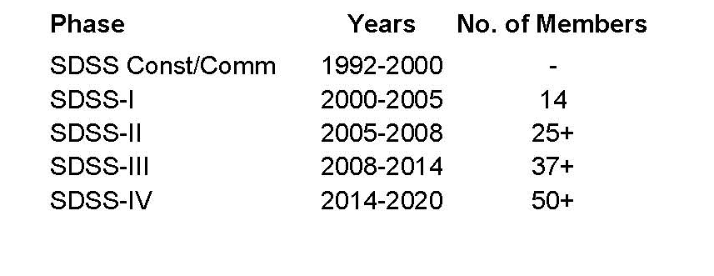

For more information visit:
Sloan Digital Sky Survey
SDSS-I/II www.sdss.org
SDSS-III www.sdss3.org
SDSS-IV www.sdss3.org/future

Slide 28
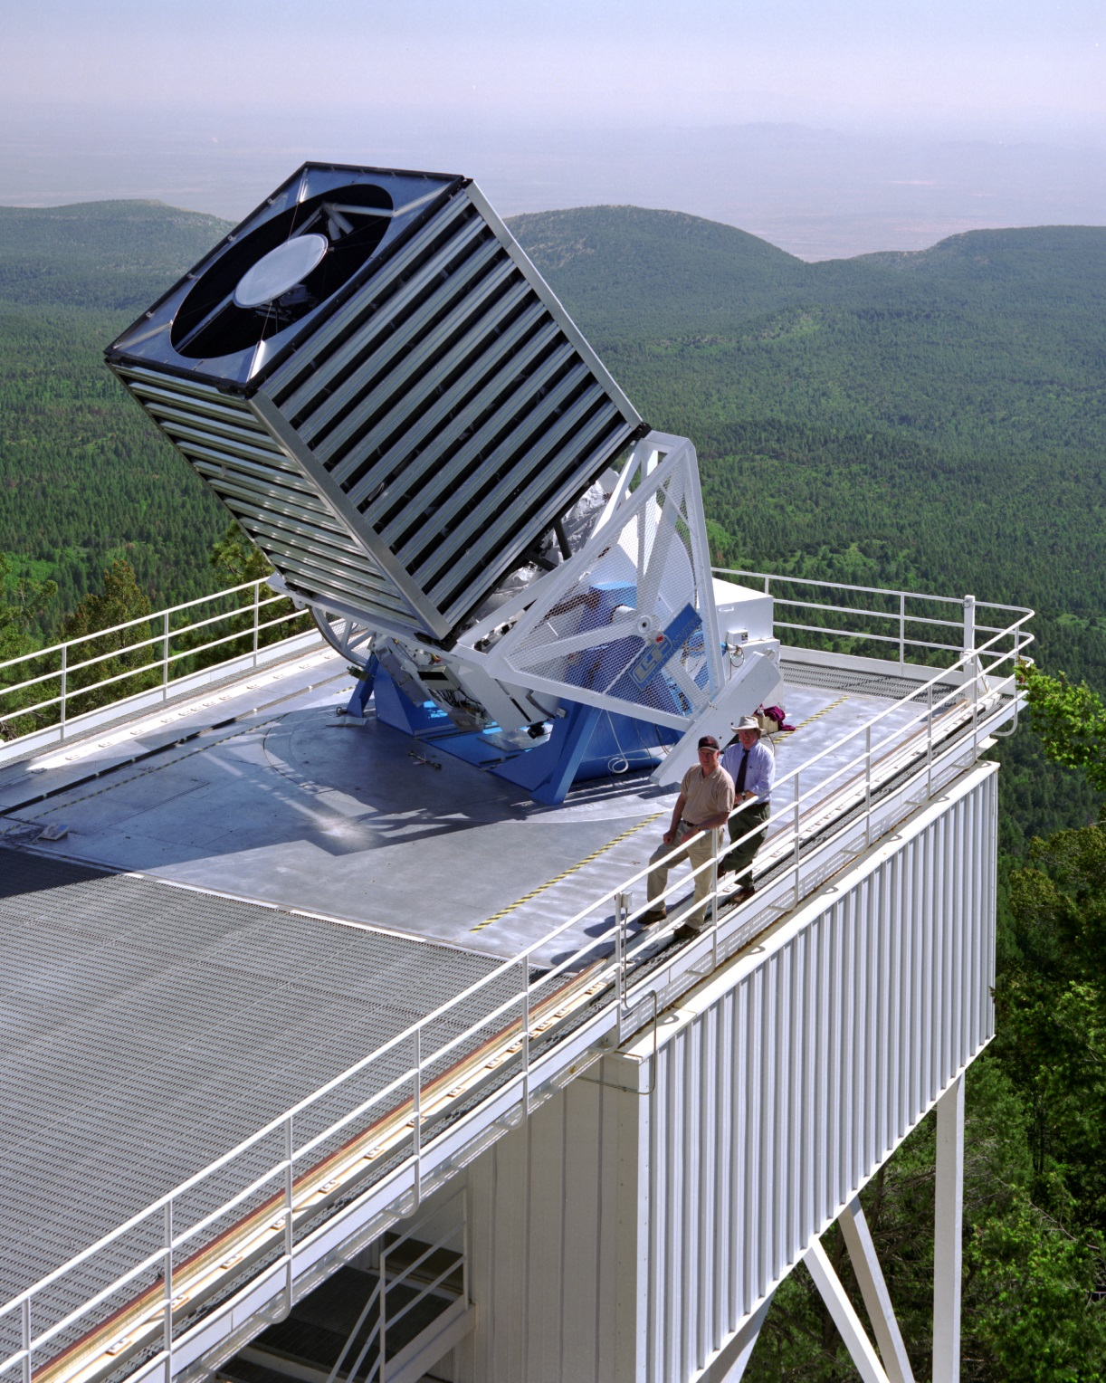

Slide 29
Let’s celebrate…
30 years of ARC’s existence
  20-year anniversary of the dedication of the 3.5m telescope
  APO providing quality observing time to astronomers and students
  Successful completion of SDSS-III observing next month

Slide 30
